Slide 1
The Privacy and Security Behaviors of Smartphone
App Developers
Rebecca Balebako, Abigail Marsh, Jialiu Lin, Jason Hong, Lorrie Faith Cranor
Notes:
Presented at USEC 2014
http://www.usecap.org/usec14.html

Slide 2
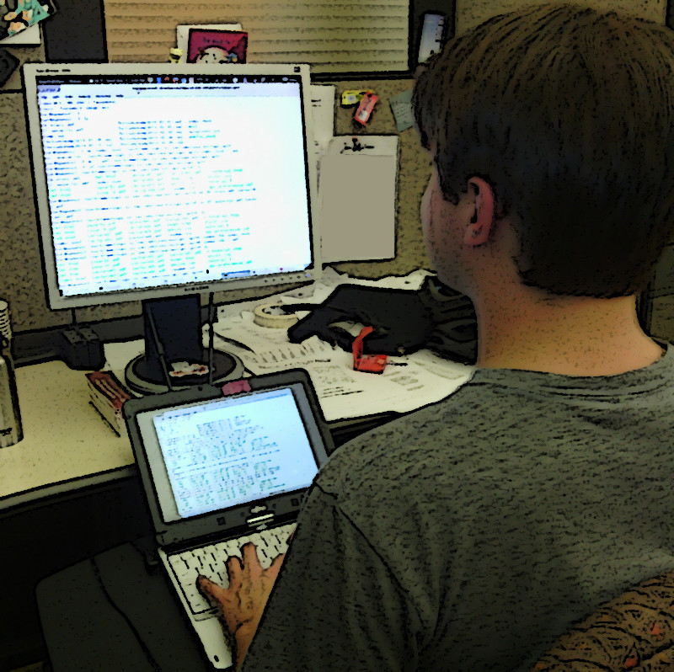
App Developer decisions
Privacy and Security features compete with
  Features requested by customers
  Data requested by financers
  Revenue model

Slide 3
Research Project
Exploratory Interviews
Quantitative on-line study

Slide 4
Findings
Small companies lack privacy and security behaviors
Small company developers rely on social ties for advice
Legalese hinders reading and writing of privacy policies
Third-Party tools heavily used
Notes:
Opportunities to teach
So what or now what?
Call to action
- usable tools
- third-party librarues

Slide 5
Participant Recruitment
13 developers interviewed
Recruited through craigslist and Meetups
$20 for one-hour interview

Slide 6
Participant Demographics
Variety of revenue models
  Advertising
  Subscription
  Pay-per-use
  Non-Profit
Seven different states
Small company size well-represented

Slide 7
Tools impact privacy and security
Interviewees do:
  Use cloud computing
  Use authentication tools such as Facebook
  Use analytics such as Google and Flurry
  Use open source tools such as mysql

Slide 8
Tools not used
Interviewees don’t use or are unaware of:
  Use privacy policy generators
  Use security audits
  Read third-party privacy policies
  Delete data

Slide 9


Slide 10
On-line surveys
228 app developers
Paid $5 (avg: 15 minutes)
Recruited through craigslist, reddit, Facebook, backpage.com
Developer demographics
  Majority were ‘Programmer or Software Engineer’ or ‘Product or Project Manager’
  Avg age: 30 (18-50 years)
Notes:
Discarded 232 results.

Slide 11
Company demographics
Platforms
  iOS (62%)
  Android (62%)
  Windows (17%)
  Blackberry (4%)
  Palm (3%)
Large Company Size well-represented
Notes:
1 employee: 5%
2-9 employees: 15%
10-30 employees: 20%
31-100 employees: 48%
100+ employees: 12%

Slide 12
Data collected or stored
Behavior | Collect or Store
Parameters specific to my app | 84%
Which apps are installed | 74%
Location | 72%
Sensor information (not location-related) | 63%

Slide 13
Privacy and security behaviors
Behavior | Percent
Use SSL | 84%
Encrypt everything (all data collected) | 57%
Have CPO or equivalent | 78%
Privacy Policy on website | 58%
Room for improvement!

Slide 14
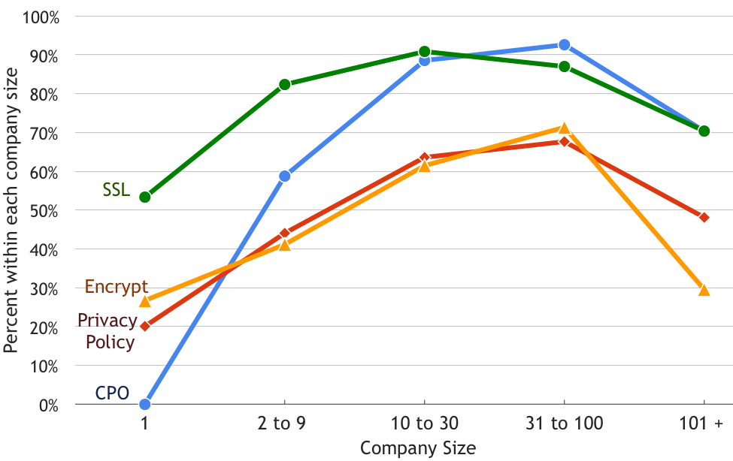
Company size and behaviors
Notes:
We found that the size of a company does help determine
whether they have a CPO (2 test p< 0.001), whether they have
a privacy policy (2 tests p=.002), and whether they encrypt
everything (2 tests p< 0.001). However, the company size
was not correlated with SSL using the conservative corrected
significance level (2 tests p=.009).

Slide 15
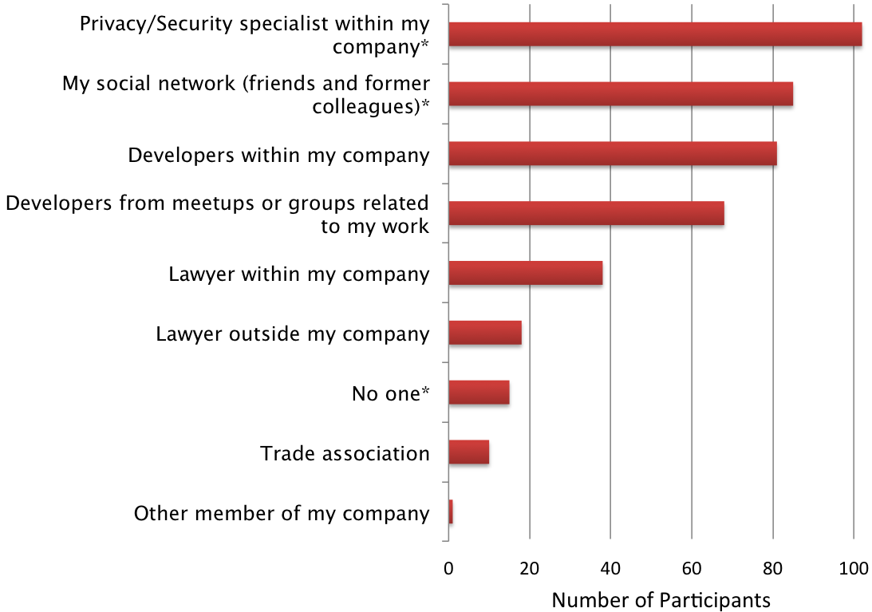
Who do you turn to?
Notes:
“Who, if anyone, do
you turn to when you have questions about consumer privacy and security?”

Slide 16
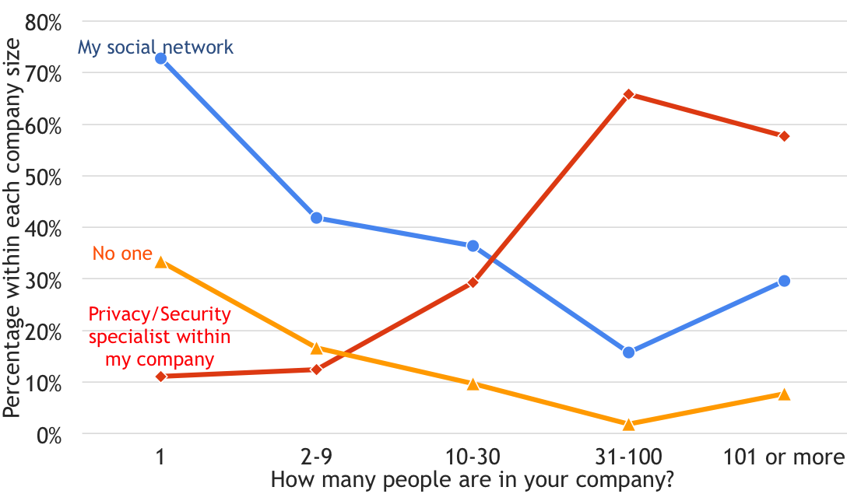
Who do you turn to?
Notes:
“Who, if anyone, do
you turn to when you have questions about consumer privacy and security?”
Options included: Developers from meetups, developers within my company, lawert within and outside company
Kruskal-Wallis test p<.0001

Slide 17
Ad and analytics heavily used
87.4% use at least one analytics company
86.5% use at least one advertising company
Notes:
most app developers (87.4\%) used at least one analytics company, with one in five using two or more analytics companies.
Most apps also used an advertising company: 86.5\% selected one or more advertising companies in use, using on average 1.78 ad companies (SD=1.33).

Slide 18
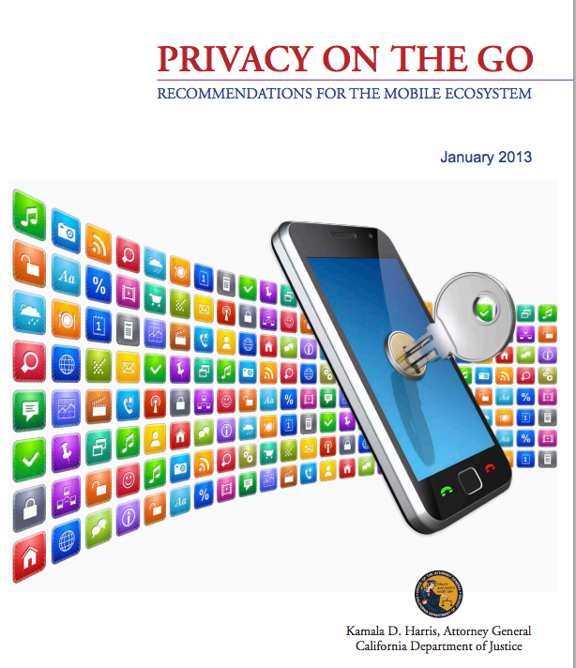

Third-party tools
Notes:
Many tools or documents that help app developers make privacy decisions discuss third-party data sharing. For example, The CA AG recommendation says that app developers should…

Slide 19
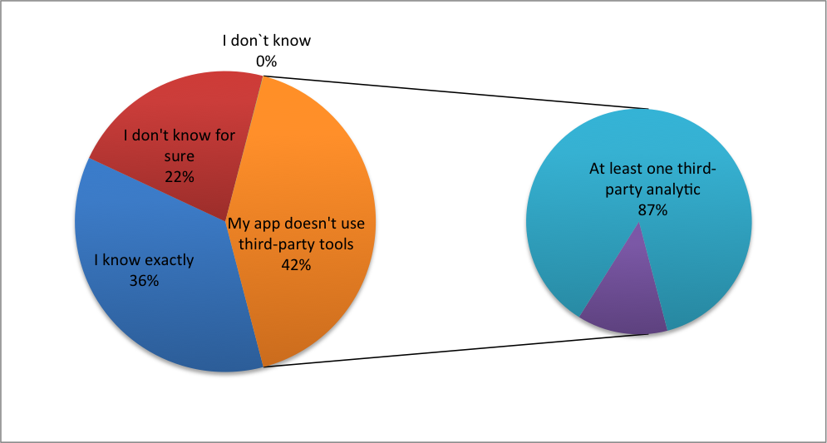
How Familiar Are You With The Types Of Data Collected By Third-Party Tools
Notes:
This is indicates that users are confused about the term ‘third-party tools’ and that tools and documents should clarify that these include ads and analytics
Pie chart fonts are to small to see

Slide 20
Findings
Small companies lack privacy and security behaviors
  Free or quick tools needed
  Usable tools needed
Small company developers rely on social ties for advice
  Opportunities for intervention in social networks
Legalese hinders reading and writing of privacy policies
Third-Party tools heavily used
  Third-party tools should be explicit about data handling
Notes:
Ooputunities to teach
So what or now what?
Call to action
- usable tools
- third-party librarues

Slide 21
Questions?
balebako@cmu.edu

Slide 22
Privacy Policies Are Not Considered Useful
“I haven’t even read [our privacy policy]. I mean, it’s just legal stuff that’s required, so I just put in there.” – P4

Slide 23
Developers have time and resource constraints
“I don’t see the time it would take to implement that over cutting and pasting someone else’s privacy policies.... I don’t see the value being such that that’s worth it.”
  -P10

Slide 24
Privacy and security behaviors
Behavior | Percent
Use SSL | 83.8%
Encrypt data on phone | 59.6%
Encrypt data in database | 53.1%
Encrypt everything (all data collected) | 57.0%
Revenue from advertising | 48.2%
Have CPO or equivalent | 78.1%
Privacy Policy on website | 57.9%

Slide 25
Ad and analytics
Ad or analytic provider | percent
Google analytics | 82%
Google ads | 64%
Flurry analytics | 17%
No ads | 13%
No analytics | 13%
Notes:
most app developers (87.4\%) used at least one analytics company, with one in five using two or more analytics companies.
Most apps also used an advertising company: 86.5\% selected one or more advertising companies in use, using on average 1.78 ad companies (SD=1.33).

Slide 26
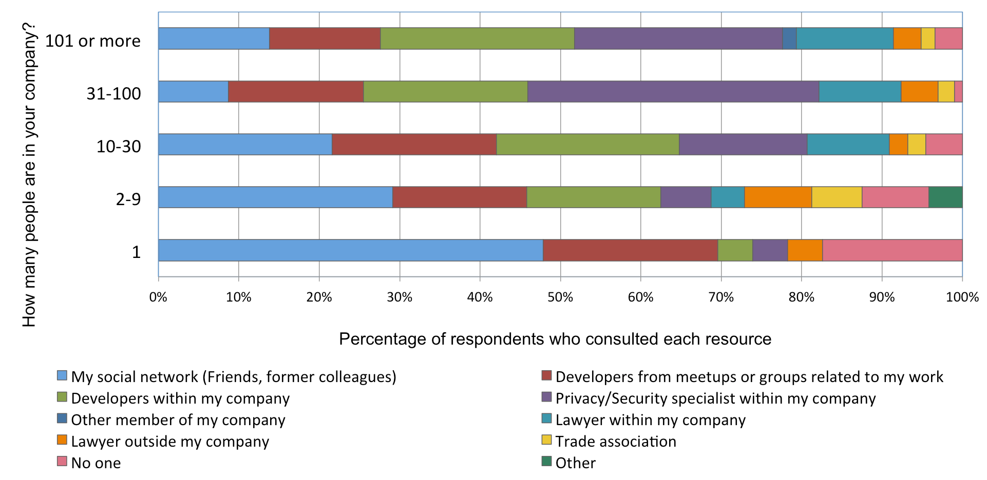
Advice
Notes:
Who if anyone, do you turn to when you have questions about privacy and security

